Slide 1
RFM model-based customer segmentation
UK e-commerce Data
Final Project - Mohammad Erwinsyah H.

Slide 2
Table of contents
01
02
03
Project Background
Data Preprocessing
Exploratory Data Analysis
04
05
Modelling
Business Insights and Actionables

Slide 3
01
Project
Background

Slide 4
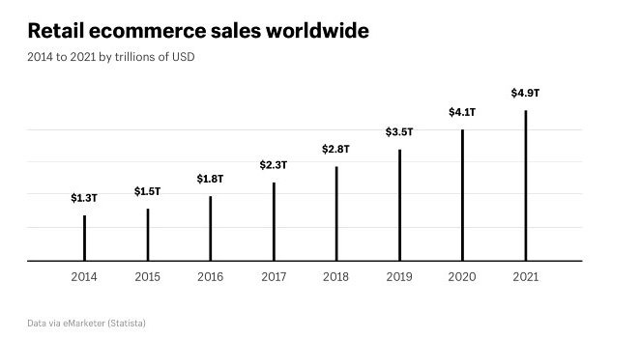
e-commerce on the rise
Source : www.statista.com
As internet access and adoption are rapidly increasing worldwide, the number of digital buyers keeps climbing every year. In 2020, over two billion people purchased goods or services online, and during the same year, e-retail sales surpassed 4.2 trillion U.S. dollars worldwide. In the year of the pandemic, global retail e-commerce sales grew with more than 25 percent.

Slide 5

So, about customers..
It can cost up to 5 times more to acquire a new customer than retaining an existing one
Success rate of selling to a current customer is 60-70% compared to only 5-20% success rate of selling to a new customer
Increasing customer retention by 5% can increase profits from 25-95%

Slide 6

Why segment customers?
Lots of benefits! Like:
Help identify least and most profitable customers
Helps build loyal relationships with customers
Helps improve or tweak products to meet customer requirements
Helps maximize profits

Slide 7
1
2
3
4
Problem
Goal
Objective
Output
How do we retain customers?
Better customer retention and prevent churn
Make a customer segmentation model
Actionables for customer segments, to improve profit and minimize cost

Slide 8
02
Data
PreProcessing

Slide 9
Dataset Information
541.909
8
rows
features
InvoiceNo
InvoiceDate
CustomerID
Country
StockCode
Description
Quantity
UnitPrice

Slide 10
Column | Description | Data Type | Missing Value | Remarks
InvoiceNo | Invoice number, a 6-digit integral number uniquely assigned to each transaction. | object | 0 | If this code starts with letter 'c', it indicates a cancellation.
StockCode | Product (item) code, l, a 5-digit integral number uniquely assigned to each distinct product | object | 0
InvoiceDate | Invoice Date and time, the day and time when each transaction was generated. | object | 1454 (0.26%)
Description | Product (item) name | numerical | 0
Quantity | The quantities of each product (item) per transaction | object | 0
UnitPrice | Unit price, product price per unit in sterling | numerical | 0
CustomerID | Customer number | object | 135080 (24.9%)
Country | Country name, the name of the country where each customer resides | object | 0

Slide 11
Missing Values and Duplicate Data
135.080
5.228
Missing Values
Duplicate Entries

Slide 12
Feature Engineering | RFM Model
Recency
Frequency
Monetary
Make new dataframe based on customers for modelling, with new features
The freshness of customer activity
time since last order (days)
modified from ‘InvoiceDate’ feature
The frequency of customer transactions
total number of transactions
modified from ‘InvoiceNo’ feature
The intention of customer to spend, or customer purchasing power
total transactions value
modified from ‘Quantity’ & ‘UnitPrice’ features

Slide 13
RFM Score Scale*
Score | Recency Scale | Frequency Scale | Monetary Scale
1 | > 6 months | < 10 times | < £200
2 | > 3 months | < 20 times | < £350
3 | > 1½ months | < 40 times | < £600
4 | > 3 weeks | < 60 times | < £1000
5 | < 3 weeks | > 60 times | > £1000
*rough estimates, rounded

Slide 14
RFM Table Sample
Customer ID | Recency | Frequency | Monetary | R Score | M Score | F Score | RFM Score
12585 | 233 days | 87 times | £2040 | 1 | 5 | 5 | 155
13450 | 26 days | 71 times | £2044 | 4 | 5 | 5 | 455
13495 | 7 days | 48 times | £2045 | 5 | 5 | 4 | 554
14001 | 45 days | 39 times | £2043 | 4 | 5 | 4 | 454
14188 | 30 days | 65 times | £2054 | 4 | 5 | 5 | 455

Slide 15
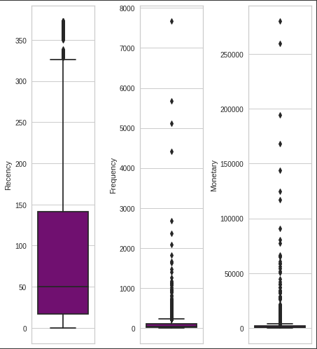
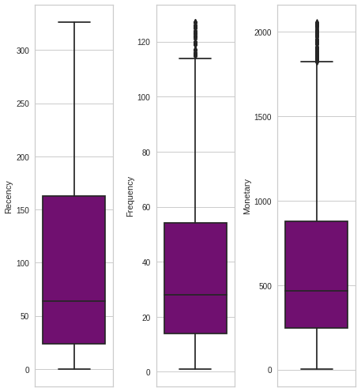
Outlier Handling
IQR method, with no iteration
Before
After
3.097
customers

Slide 16
03
Exploratory
Data Analysis

Slide 17
3.665
18.532
Products Sold
Transactions

Slide 18
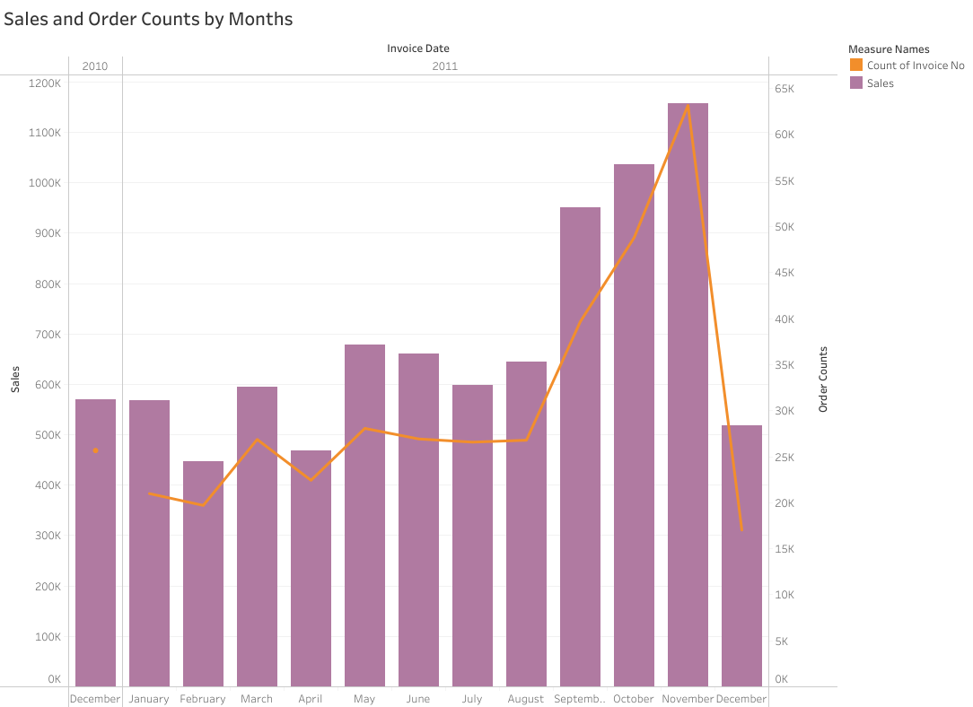
EDA Insight
November 2011
Recorded transactions from December 2010 - December 2011
When Sales and Order Counts peaked

Slide 19
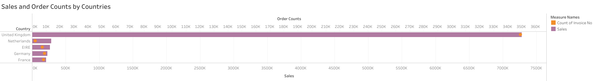
EDA Insight
United Kingdom
Top 5 Countries with highest sales
dominates sales and order counts

Slide 20
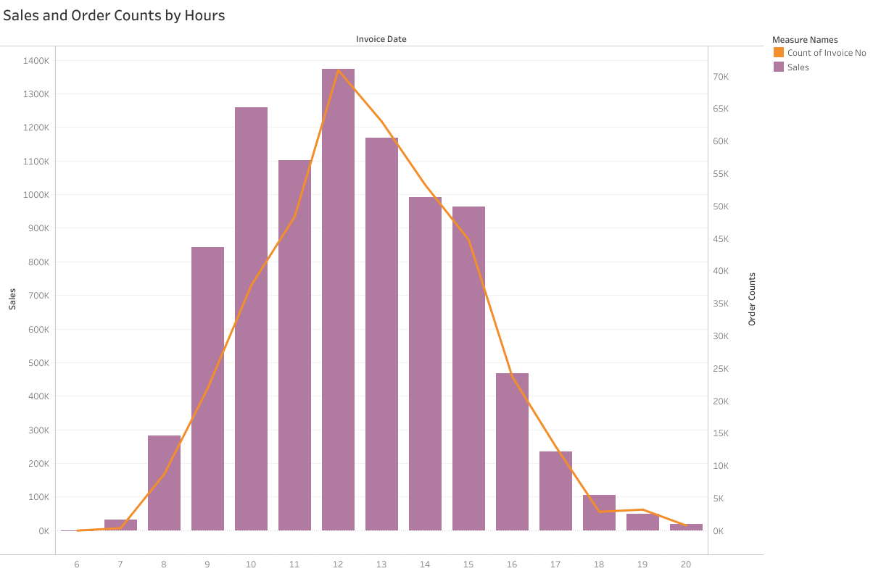
EDA Insight
12 p.m.
This online retail operates from 6 a.m. - 20 p.m.
When Sales and Order Counts peaked

Slide 21
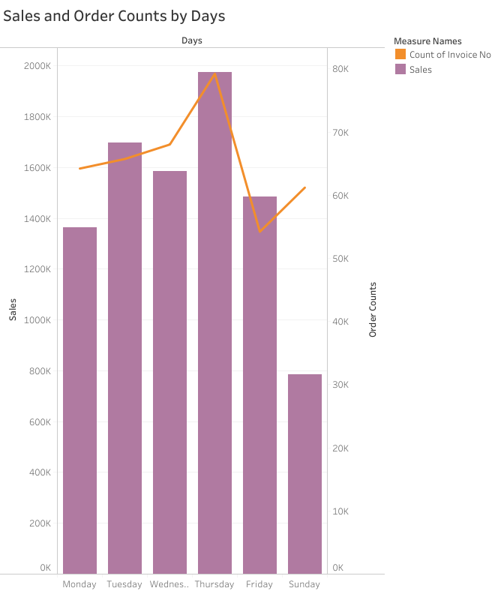
EDA Insight
Thursday
No transactions on Saturday
When Sales and Order Counts peaked

Slide 22
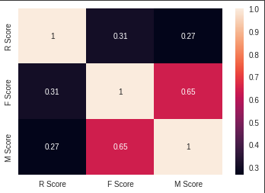
EDA Insight
0.65
Moderate Correlation between F Score and M Score
Correlation Score

Slide 23
04
Modelling

Slide 24
Clustering Comparison
Model | Cluster | Silhouette Score* (-1 to 1) | Evaluation
K-means clustering on Recency, Frequency, and Monetary values | 3 Clusters | 0.40 | Clusters customers into: Best Customers Potential Customers Lost Customers
K-means clustering on R Score, F Score, and M Score | 4 Clusters | 0.34 | Clusters customers into: Best Customers Potential Customers At Risk Customers Lost Customers
Manual Segmentation using RFM Score | 11 Segments | - | Segments customers into 11 clusters with more depth and nuance compared to ML model
*) The silhouette score of 1 means that the clusters are very dense and nicely separated. The score of 0 means that clusters are overlapping. The score of less than 0 means that data belonging to clusters may be wrong/incorrect

Slide 25
05
Business Insights
&
Recommendations

Slide 26
RFM Segmentation
3.097 customers
Recency (time since last trx)
≥ 8 months
4-7 months
0 - 2 months
Can’t Lose Them
92
(2.97%)
At risk
417
(13.46%)
Promising
171
(5.52%)
Need Attention
161
(5.2%)
Loyal
280
(9.04%)
Champions
462
(14.9%)
> £500
> 30 trx
Monetary
Lost
246
(7.94%)
Hibernating
488
(15.76%)
About to Sleep
119
(3.84%)
New Customers
250
(8.07%)
Potential Loyalist
411
(13.27%)
< £500
< 20 trx
> 30 trx
Frequency (number of trx)

Slide 27
Segment | Last Trx | Trx | Avg Spending | Customer Count | Customer Count (%) | Total Spending | Total Spending (%)
1. Champions | ½ month | 76 | £1,233 | 462 | 14.92% | £569,661 | 29,56%
2. Loyal Customers | 2 months | 58 | £1,069 | 280 | 9.04% | £299,404 | 15,54%
3. Potential Loyalist | 1 month | 44 | £385 | 411 | 13.27% | £158,328 | 8,22%
4. New Customers | 1 month | 9 | £170 | 250 | 8.07% | £42,400 | 2,20%
5. Promising | 1 month | 13 | £612 | 171 | 5.52% | £104,678 | 5,43%
6. Need Attention | 1½ months | 34 | £756 | 161 | 5.2% | £121,790 | 6,32%
7. About to Sleep | 4 months | 19 | £203 | 119 | 3.84% | £24,098 | 1,25%
8. At Risk | 6 months | 49 | £805 | 417 | 13.46% | £335,806 | 17,43%
9. Can’t Lose Them | 7 months | 38 | £940 | 92 | 2.97% | £86,468 | 4,49%
10. Hibernating | 5 months | 17 | £301 | 488 | 15.76% | £146,719 | 7,61%
11. Lost | 8 months | 10 | £153 | 246 | 7.94% | £37,706 | 1,96%
*rough estimates, rounded

Slide 28
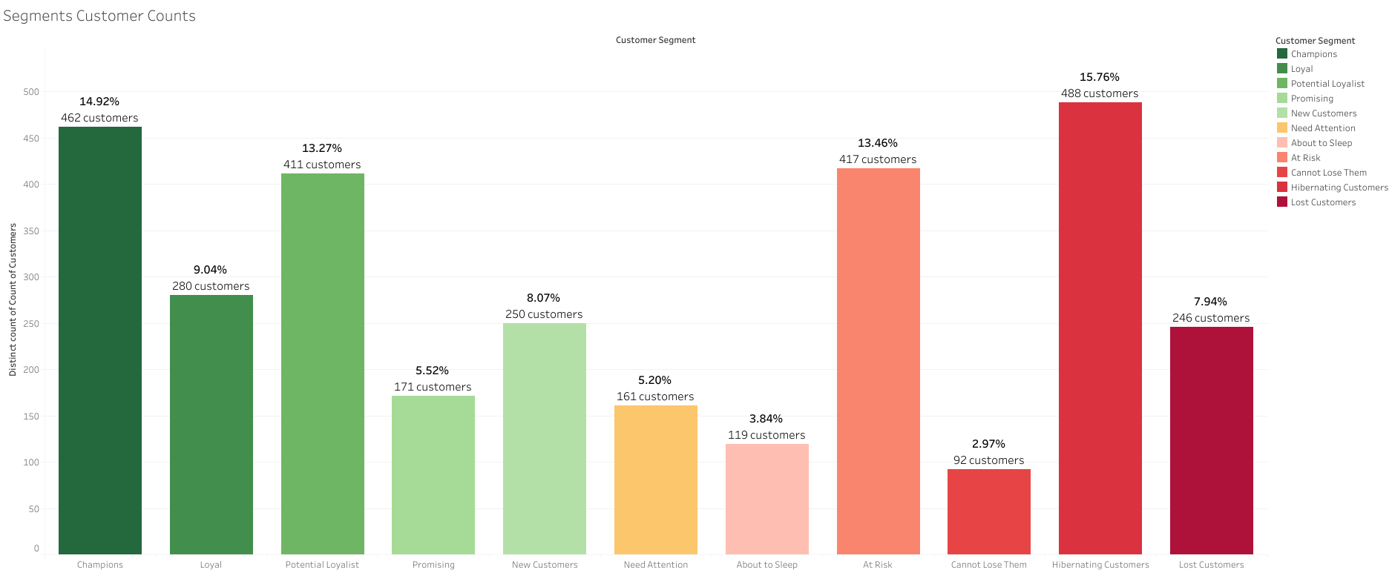
Segments Customer Counts
Hibernating Customers
Segment with most customers

Slide 29
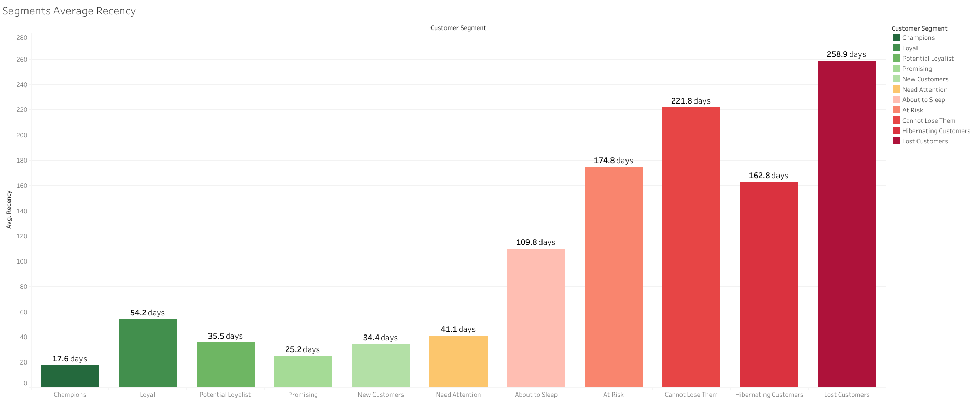
Segments Average Recency
3 months
Cut-off before customers start falling off

Slide 30
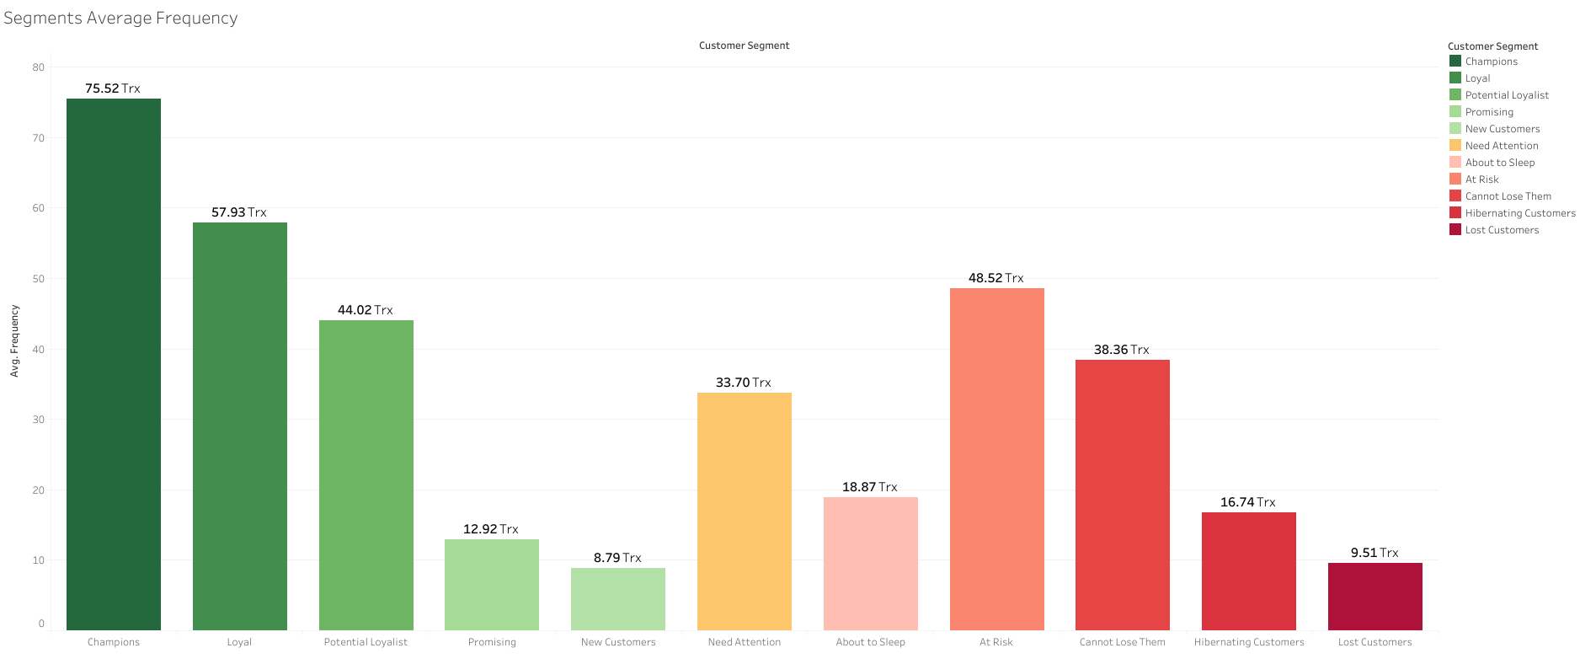
Segments Average Frequency
5-6 Trx/month
In average, number of transactions of best customers

Slide 31
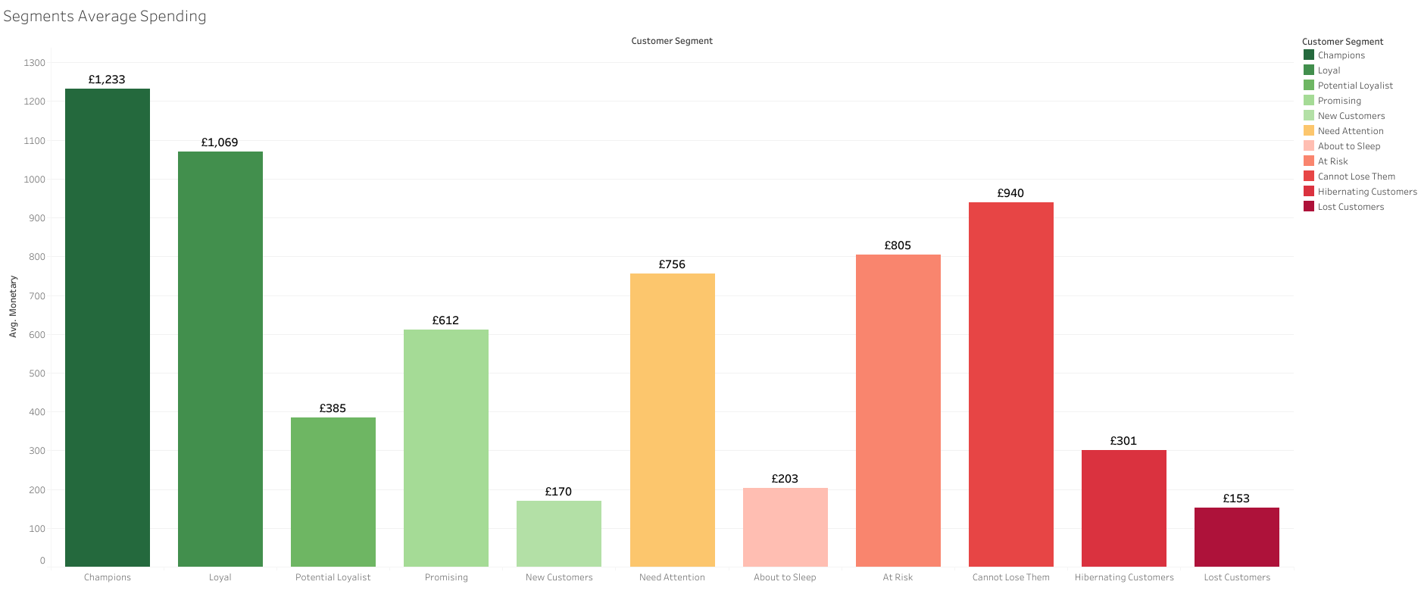
Segments Average Spending
Can’t Lose Them
At Risk
Need Attention
Segments with great value when converted back

Slide 32
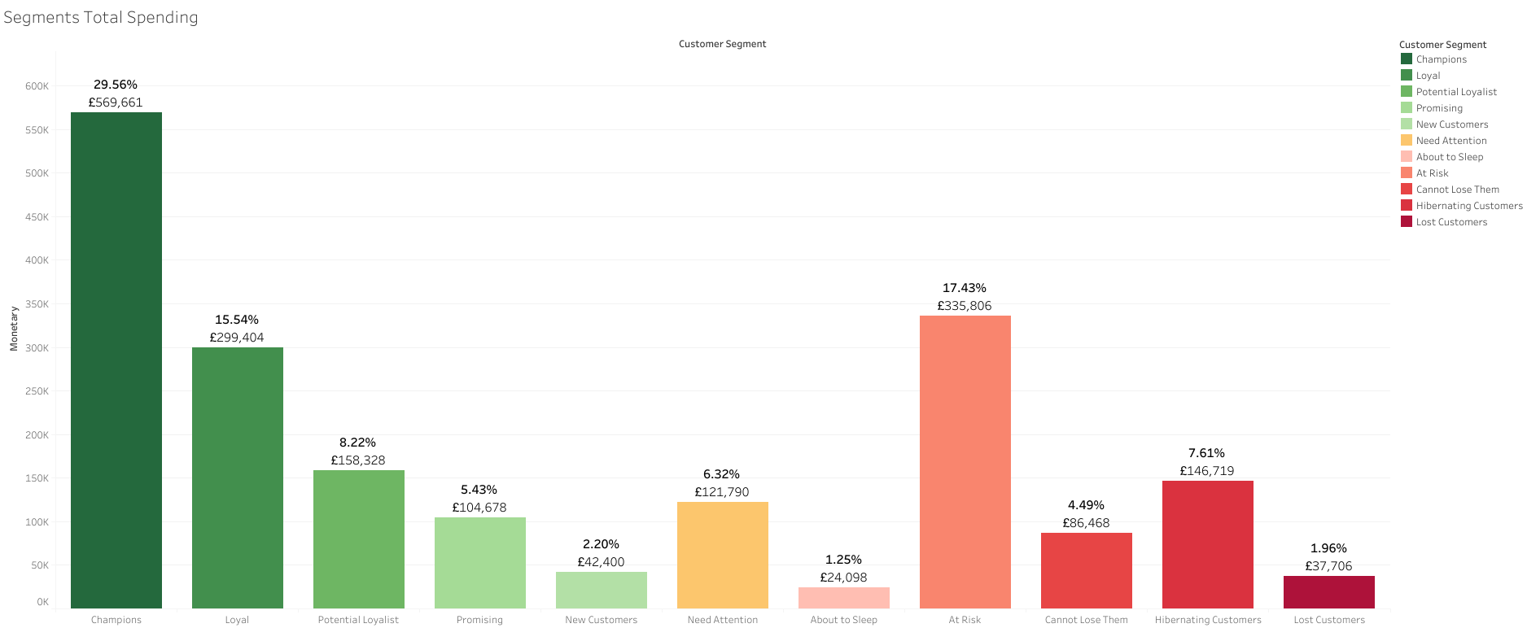
Segments Total Spending
Up to 29.56%
Revenue comes from only 14.9% customers (Champions)

Slide 33
Actionables
Customer Segment | Scores | Activity | Actionable Tip
Champions | 555, 554, 544, 545, 454, 455, 445 | Bought Recently, buy often and spend the most! | Reward them. Can be early adopters for new products. Will promote your brand.
Loyal Customers | 543, 444, 435, 355, 354, 345, 344, 335 | Spend good money with us often. Responsive to promotions. | Upsell higher value products. Ask for reviews. Engage them.
Potential Loyalist | 553, 551, 552, 541, 542, 533, 532, 531, 452, 451, 442, 441, 431, 453, 433, 432, 423, 353, 352, 351, 342, 341, 333, 323 | Recent customers but spent a good amount and bought more than once. | Offer membership / loyalty program, recommend other products.
New Customers | 512, 511, 422, 421 412, 411, 311 | Bought most recently, but not often. | Provide on-boarding support, give them early success, start building relationship.
Promising | 525, 524, 523, 522, 521, 515, 514, 513, 425,424, 413,414,415, 315, 314, 313 | Recent shoppers, but haven’t spent much. | Create brand awareness, offer free trials.
Need Attention | 535, 534, 443, 434, 343, 334, 325, 324 | Above average recency,frequency and monetary values. May not have bought very recently though. | Make limited time offers. Recommend based on past purchases. Reactivate them.
About To Sleep | 331, 321, 312, 221, 213, 231, 241, 251 | Below average recency, frequency and monetary values. Will lose them if not reactivated. | Share valuable resources, recommend popular products / renewals at discount, reconnect with them.
At Risk | 255, 254, 245, 244, 253, 252, 243, 242, 235, 234, 225, 224, 153, 152, 145, 143, 142, 135, 134, 133, 125, 124 | Spent big money and purchased often. But not long time ago. Need to bring them back! | Send personalized e-mails to reconnect, offer renewals, provide helpful resources.
Can’t Lose Them | 155, 154, 144, 214,215,115, 114, 113 | Made biggest purchases, and often. But haven’t returned for a long time | Win them back via renewals or newer products. Don’t lose them to competition, talk to them.
Hibernating | 332, 322, 233, 232, 223, 222, 132, 123, 122, 212, 211 | Last purchase was long back, low spenders and low number of orders. | Offer other relevant products and special discounts. Recreate brand value.
Lost | 111, 112, 121, 131,141,151 | Lowest recency, frequency and monetary scores. | Revive interest with reach out campaign, ignore otherwise.

Slide 34
Conclusion
Customer segmentation with the RFM methodology in sales is an effective way to help employees to focus their efforts by targeting customers on a priority basis and taking different actions on them.
When taking actions, it can help to focus on segments that are low hanging fruits.
This kind of project is also flexible as the number of segments can be adapted to the business needs, and the period of time in the analysis can be extended or reduced as well.
Things to improve:
Data Cleaning and Preparation
Modelling

Slide 35
Thanks!
Does anyone have any questions?

